Slide 1
Free Design, Free Idea
Deadline: 01/05/2022 ( one week)

Slide 2
Introduction about country
Demographics
Politics
Economy
Geography
History
Culture
A
G
E
N
D
A

Slide 3
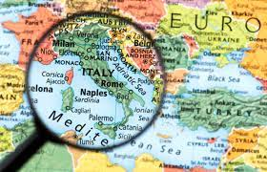
Introduction about country
Italy
Slovenia
Switzerland
Austria
France
Holy See
San Marino

Slide 4
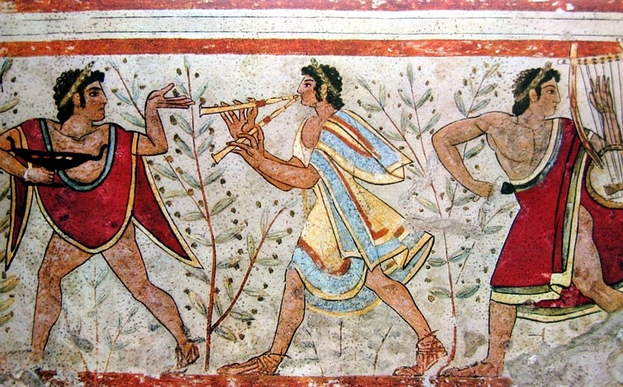
History
Prehistory and antiquity

Slide 5
Geography

Slide 6
Politics

Slide 7
Economy

Slide 8
Demographics

Slide 9
Culture

Slide 10
History

Slide 11
History

Slide 12
History

Slide 13
History

Slide 14
Introduction about country

Slide 15





Questions
www.passerellesnumeriques.org

